Slide 1

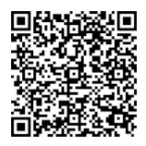

Siempre más
for your family
Check out a conversation with some Fidelity Latino financial professionals, sharing stories about life, family,
and how culture has shaped their outlook on money.
NO APP NEEDED.
Fidelity Brokerage Services LLC, Member NYSE, SIPC, 900 Salem Street, Smithfield, RI 02917
© 2024 FMR LLC. All rights reserved. 1158310.1.0

